Slide 1
ATM Automata
Andrew Fernandez
Anthony Reveron
Kyle Hemsley

Slide 2
Overview
Basics
Only needs a relatively low number of states
Requires memory, networking
Abstracted in project
Special considerations:
High security (PCI compliance)
High reliability (24/7, unattended, public-facing operation)

Slide 3
State Overview (Simplified)
Good Account
Good PIN
Quit
Welcome Page
Pin Entry
Main Menu
Goodbye Page
Bad Account
Bad PIN
Auth Failure
(Lockout)
View Balance
Deposit
Withdraw
All 3 States Able to Return to Menu or Quit

Slide 4
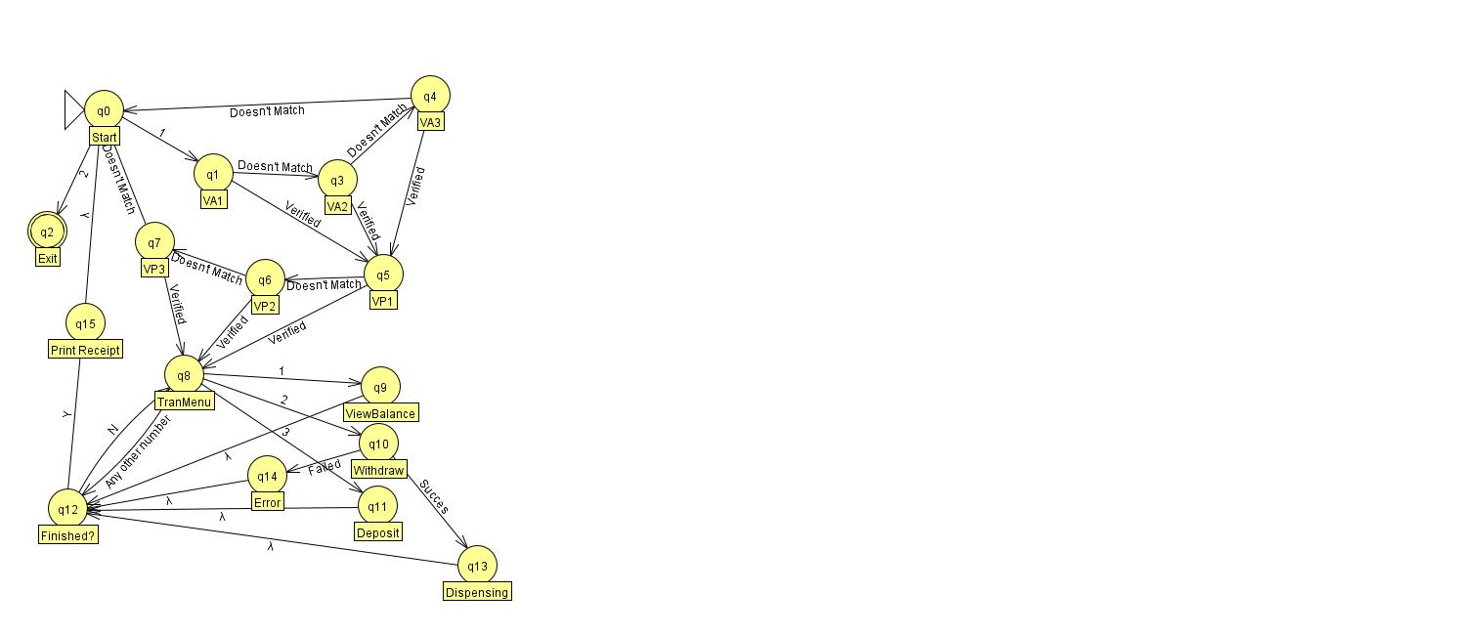
State diagram for our program

Slide 5
Security Functions
ATM is locked if bad account or bad PIN is seen repeatedly
Protects against brute force attacks
No transitions from any final state to allow replay attacks
Customer balance is verified before withdrawal

Slide 6
UX Functions
Menu workflow allows multiple transactions per swipe + PIN
Clear feedback for bad PIN, bad Account
Clear feedback for security lockout
Clear closing screen
Thanks customer for their business
Gives information of the ATM session (receipt)
Informs them that the ATM is now locked

Slide 7
Customer Data
Out of scope for project
Stored on ATM only during state execution
Database is abstracted as perfectly reliable, with infinite space
Data is trusted implicitly

Slide 8
Objects vs States
OOP allows for parallel logic design to finite automata
Classes can represent states
Transitions can be private functions - hidden from the implementation
Enhanced security
Enhanced robustness
Enhanced ability to audit regulatory compliance
Allows firm definition of problem scope
One state machine ends and another begins

Slide 9
Challenges
Input parsing and robustness
Authentication, Validation
Accurate accounting of funds
Enforcing withdrawal quantity restrictions

Slide 10
Real-World Challenges
Ensure changes are written to network storage before cash is dispensed or customer is shown an updated balance
“Write through” policy
Demands higher than normal storage performance
Implement a timeout to make sure users do not walk away from an active session

Slide 11
Conclusions
Automata principles can be found in everyday machines
ATMs
Vending Machines
Parking Meters
Basic Automata well-suited for proofing
Thus well-suited for security and reliability

Slide 12
Works Cited
Wang, Yingxu, et al. The Formal Design Model of an Automatic Teller Machine (ATM). International Journal of Software Science and Computational Intelligence, Jan. 2010, pdfs.semanticscholar.org/e1a4/dab983c2205b1e116ffd9cf3571f22c31a25.pdf.
Verma, Sadhana, and Ajay Pratap. Designing of Testing Framework through Finite State Automata for Object-Oriented Systems Using UML. International Journal of Computer Applications, Oct. 2015, pdfs.semanticscholar.org/d199/64294ea4d0386c3618f62aa731f4d998bf37.pdf.

Slide 13
Questions

